Slide 1

ONLINE FURNITURE AUCTION SYSTEM
CONFIDENCE ONYEDINMA (CST20HND0406)
Supervised by: MR. MUHAMMAD HARUNA ISA

Slide 2







Table of Content
Background of the Study
Statement of the Problem
Aim and Objectives
1
2
3
Significance of Study
Summary of Related Literature Reviews
Research Methodology
4
5
6
System Modeling
Proposed Interface Design
Summary / Conclusion
7
8
9

Slide 3

Background of Study
A few decades ago, auctions were held in auction houses, with the auctioneer delegating bids, and this existing system necessitated the actual attendance of the bidders, resulting in a variety of limits. This resulted in the adoption of online auctioning, which allows auctions to be conducted through the internet from anywhere in the world. Aaditya et al. (2022)
Now, an online furniture auction system comes in by providing a convenient and safe means for obtaining products while also allowing for bidding. Bidding can be done anywhere with an internet connection to the website. This system enables users to put stuff for auction. The products will be accompanied by a description, selling price, and a visual presentation for the bidder to view. If the bidder is interested in the item, he or she will auction for it and then personally check it to approve it before concluding the transaction with the seller. Kokila et al. (2021).

Slide 4

Statement of the Problem
The problem with the public furniture auction is that the participation of the general public is very limited. The auction process is faced with so many difficulties, which include time, planning of the auction event, and also the movement of items to be auctioned which can also lead to the damage of some fragile items

Slide 5


Aim and Objectives of the Study
Aim
Objectives
To develop an online furniture auction system
To develop a system free of hassle for bidders
Users and product datasets will be generated upon registration on the site.
Unit and Integration testing will be carried out to ensure the effectiveness and efficiency of the design making sure that the functionalities are error-free

Slide 6
Significance of the Study
The main importance of this study is to improve the security of online furniture auctions by developing an online furniture auction system that is more secure, the study can help protect users and increase their confidence in using online auctions.

Slide 7
Summary of literature review
Title | Author & Year | Description | Merit | Demerits
Auction System | Globbi (2022) | The system aims to achieve a web based auctioning system. | A bidder can participate in the auction from anywhere with an integrated application. | Any glitch or network obstruction will interruption the auction.
Online auction fraud detection system. | Sonali et al (2018) | Online auction fraud detection system to ensure secure commercial sit for cash transaction. | Validates and verifies the product and customers. | Construction of an online feature construction of an online feature that would make available both at optimal performance as well as perception.
Online Auction Management System. | Bliss (2018) | Auction application that enables the customer bid for product within their location. | Products displayed for your view are products nearest to you as per your location for easy inspection | Products within your location might not be what you might like or want..

Slide 8
Summary of literature review
Title | Author & Year | Description | Merit | Demerits
Online Auction System | S.Kokila et al (2021) | This system enables customers bid for product of their choosing and also notifies them once they have won the bidding. | No physical presence is required as such customers experience a more convenient way of carrying out transactions. | Unavailable goods may be bid for.
Online auction system. | Patil (2022) | This system only allows buyers and sellers located in a particular environ and only registered ones. | Business transaction more efficient and effective. | Only for registered auction buyers and seller within a local area.

Slide 9
Research methodology
Choice of programming language
Method of data collection
This research work will be a web-based application and will be implemented on a relational database system (SQLite). HTML (hypertext markup language), CSS (cascading style sheet), and JavaScript for the frontend development while Django (Python) will be employed for the backend programming
Before constructing any system, it is necessary to collect data and facts about the existing system in order to comprehend what is going on. Three approaches were used in this study.
Observation of the Work Environment
Interview
Documentation

Slide 10
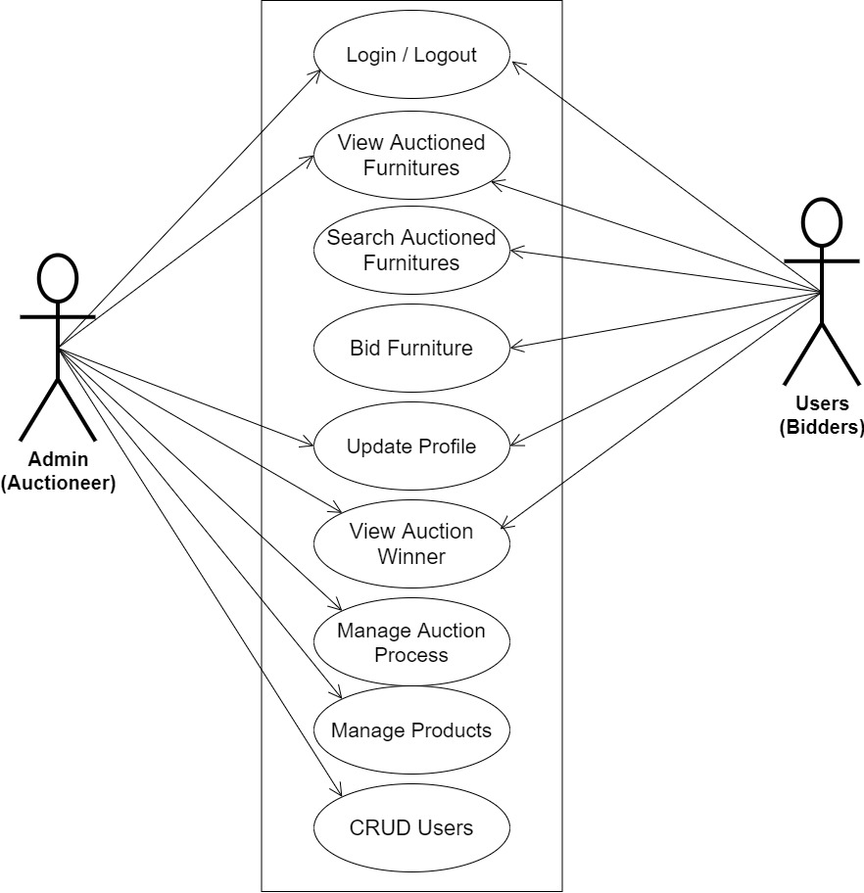
SYSTEM MODELING (USE CASE DIAGRAM)

Slide 11
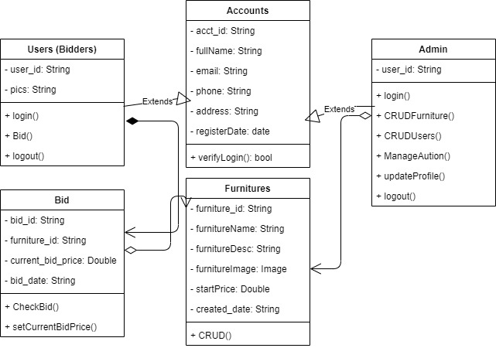
SYSTEM MODELING (CLASS DIAGRAM)

Slide 12
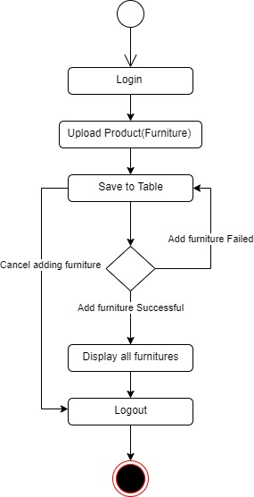
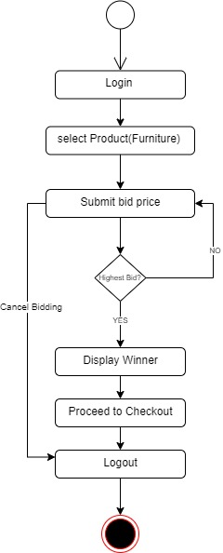
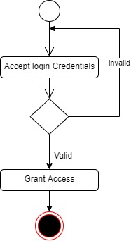
SYSTEM MODELING (ACTIVITY DIAGRAM)
Login Activity Diagram
Adding Furniture Activity Diagram
Bidding Activity Diagram

Slide 13
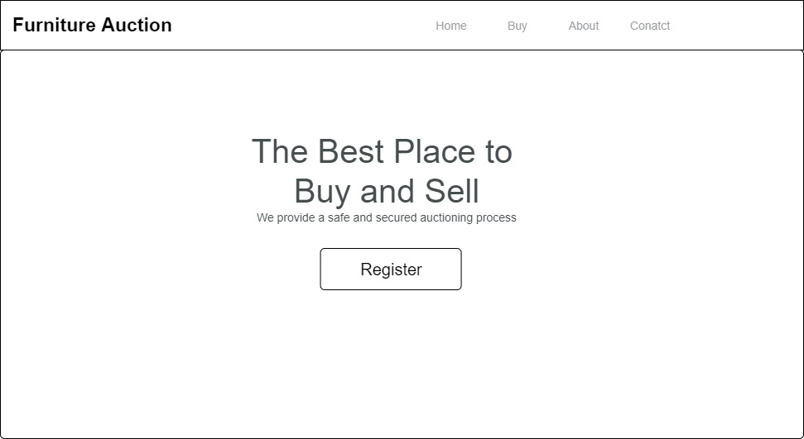
PROPOSED INTERFACE DESIGN
Home Page

Slide 14
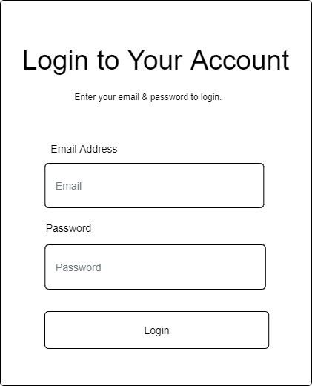
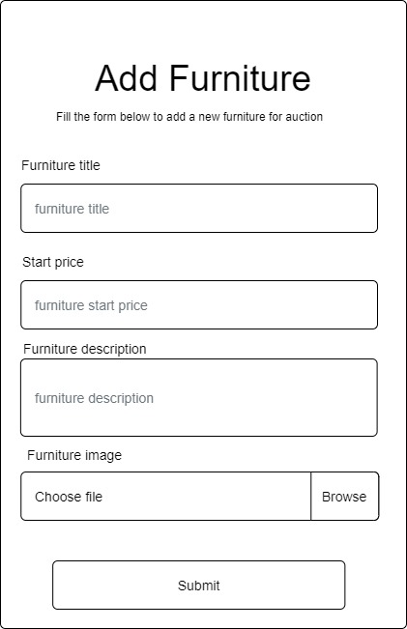
PROPOSED INTERFACE DESIGN
User Login Form
Add Furniture Form

Slide 15
Summary / Conclusion
This online furniture auction system only allows for the auctioning of furniture and will accommodate only the buyers and sellers that are registered to participate in any of the auctioning processes. This system will bring benefits by replacing the manual method of searching for things in the market and traveling large distances merely to buy a few pieces of furniture, as well as saving time.

Slide 16
Thank You

